Slide 1
Your ideas & your market
Vince Knight and Neil Coles
Thursday 6th February 2014
Week 2

Slide 2
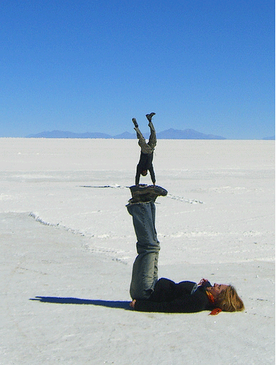

Ideas and commercial thinking
from the ultimate in cool…
today’s feature…
Dr Vince Knight & Neil Coles

Slide 3
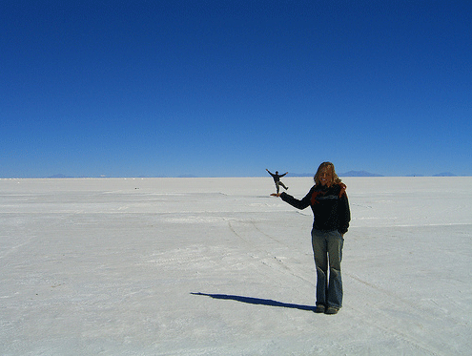
Why be a creative thinker?
Develops your problem solving ability
Generates opportunities
Notes:
Introduce overview
Develops your problem solving ability
Helps you solve problems in your everyday life
Helps you become better skilled and more attractive to an employer
Generates business opportunities
Helps you imagine and create new products and services
Helps you overcome resistance and barriers associated with your ideas

Slide 4
Edward de Bono on Creativity
Creativity makes life more fun and more interesting.”
Creativity gives the possibility of some sort of achievement to everyone.
Creativity gives hope that there can be a worthwhile idea.
“Creativity is a great motivator because it makes people interested in what they are doing.

Slide 5
Looking at things from a
different
perspective
Notes:
5

Slide 6
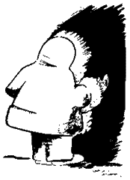
Notes:
6

Slide 7

Notes:
7

Slide 8


Slide 9

Notes:
9

Slide 10
Let’s
experience
it!
Notes:
10
10

Slide 11


The Red Brick
Notes:
11
11

Slide 12
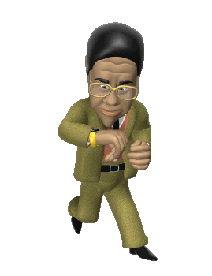
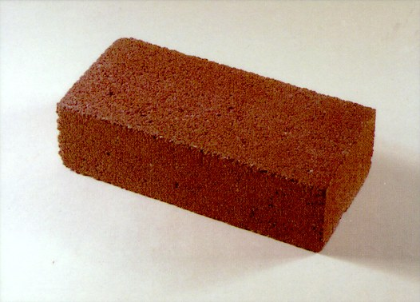

Time’s up !!
Notes:
12
12

Slide 13
Alex Faickney Osborn and Brainstorming
Focus on quantity of ideas
Welcome unusual ideas
Combine, Improve and modify
Suspend judgment
Notes:
Brainstorming
The method was developed by an advertising executive, Alex Faickney Osborn in the 1940’s and who went onto co-develop the ‘Creative Problem Solving Process (CPS) and the Creative Education Foundation
The brainstorming rules he came up with are the following:
Focus on quantity of ideas
Welcome unusual ideas - suspend assumptions
Suspend judgment - no criticism of ideas at the outset
Combine, Improve and modify - build on the ideas of others
When these rules were followed he discovered more ideas were
created and……quantity produced quality!

Slide 14
Problem definition
Market need, challenges, impacts, benefits of solution
Idea generation
Many solutions
Free thinking, association, analogy
Divergent
Idea evaluation/refinement
Top 3 – Criteria? Commonalities / Differences / Develop?
Convergent
Analyse, evaluate, judgement
Implementation
Final decisions – Criteria used?

Slide 15
Defining your market
Aims and goals:
What the business hopes to achieve.
Create value – but what value? eg. Financial, practical, social, political
Objectives:
Steps you intend to take to achieve goals/aims (targets).
Specific, Measurable, Achievable, Realistic, Time bound
Drivers:
Internal or external conditions that positively influence the aims, goals and objectives.
Examples: economic conditions, regulation, competition, market need.

Slide 16
Defining your product
Feature:
A distinguishing physical aspect of the product.
May be inherent within the design and beneficial but is not the benefit itself.
Examples: durability, low price, portability.
Benefit:
Results from the product feature(s).
A benefit is the advantageous consequence for the customer of using the product.
Examples: long lasting usage, affordable, can be used anywhere.
Value:
The consequence of features and benefits for an individual.
Examples: confidence in product (quality), positive return on investment , locational flexibility.

Slide 17
What is your….
USP
What’s different?
brand | customer service| social | price | quality | value

Slide 18
Aims, goals and drivers:
Mission statement:
(Values, stakeholders)
Company
Features & their Benefits:
Product
Clients/Customers/Markets:

Slide 19
Ideas and commercial thinking
Vince Knight and Neil Coles
Thursday 6th February 2014
Week 2

